Slide 1
UNIT – II Design of Experiments
Prepared by
Dr.S.Vanitha
VERSION 1.0

Slide 2
OBJECTIVE
To provide some basic concepts in experimental designs and its applications to industry, management and other engineering fields.

Slide 3
OUTCOME
Able to design experimental designs and use of these concepts for industry, management and other engineering fields.

Slide 4
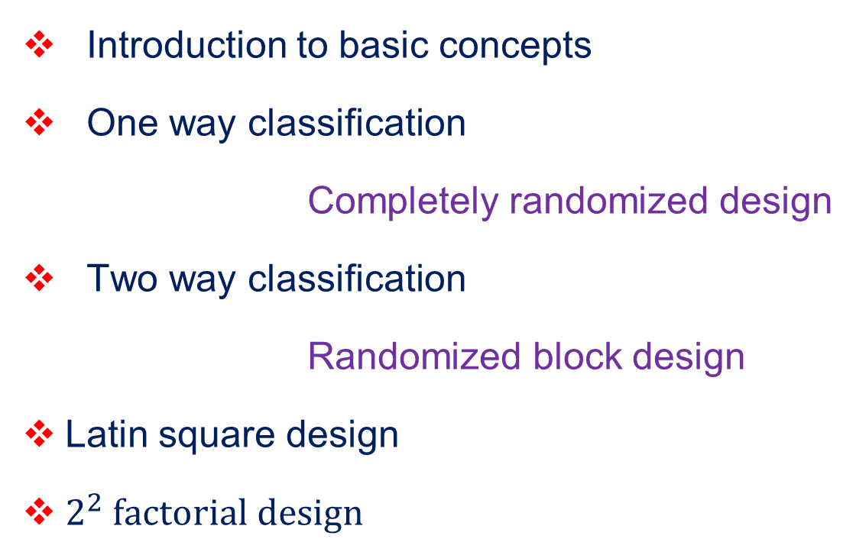
CONTENTS
Introduction to basic concepts
One way classification
Completely randomized design
Two way classification
Randomized block design
Latin square design
$2^{2} factorial design$

Slide 5
Introduction to Basic Concepts

Slide 6
Design of experiment:
The Design of experiment may be defined as the logical construction of the experiment in which the degree of uncertainty with which the inference is drawn may be well defined.
Aim of the design of experiments:
The main aim of the design of experiments is to control the extraneous variables and hence to minimize the experimental error so that the results of the experiments could be attributed only to the experimental variables.

Slide 7
Basic principles of experimental designs:
Randomization
Replication
Local control ( error control)
Analysis of Variance (ANOVA):
Analysis of Variance (ANOVA) is a technique that will enable us to test for the significance of the difference among more than two sample means. That is used to test the homogeneity of several means.

Slide 8
Assumptions in ANOVA:
Each sample is taken as a random sample.
Each sample is independent of the other sample.
Each of the sample is drawn from a normal population.
The variances for the population from which samples have been drawn are equal.
The effect of various components and interactions are additive.

Slide 9
Review Questions
What do you understand by “Design of an experiment”?
What are the basic principles of experimental designs:
What is ANOVA?
Write down the assumptions in analysis of variance.
What are the uses of analysis of variance?

Slide 10
One-way classification Completely Randomized Design (CRD)

Slide 11
In one-way classification, the data is classified according to one factor or criteria.
Completely Randomized Design (CRD):
The completely randomized design is the simplest of all designs based on the principles of randomization and replication. In this design, treatments are allotted randomly to the entire experimental units with replication.

Slide 12
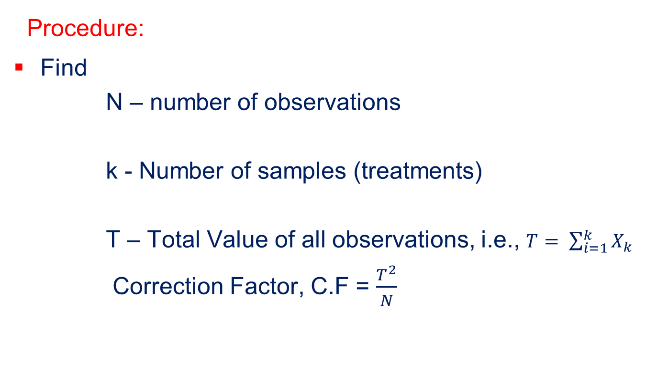
ANOVA Table Calculations
Procedure:
Find
N – number of observations
k - Number of samples (treatments)
T – Total Value of all observations, i.e., $T= \sum_{i=1}^{k}{X_{k}}$
Correction Factor, C.F = $\frac{T^{2}}{N}$

Slide 13
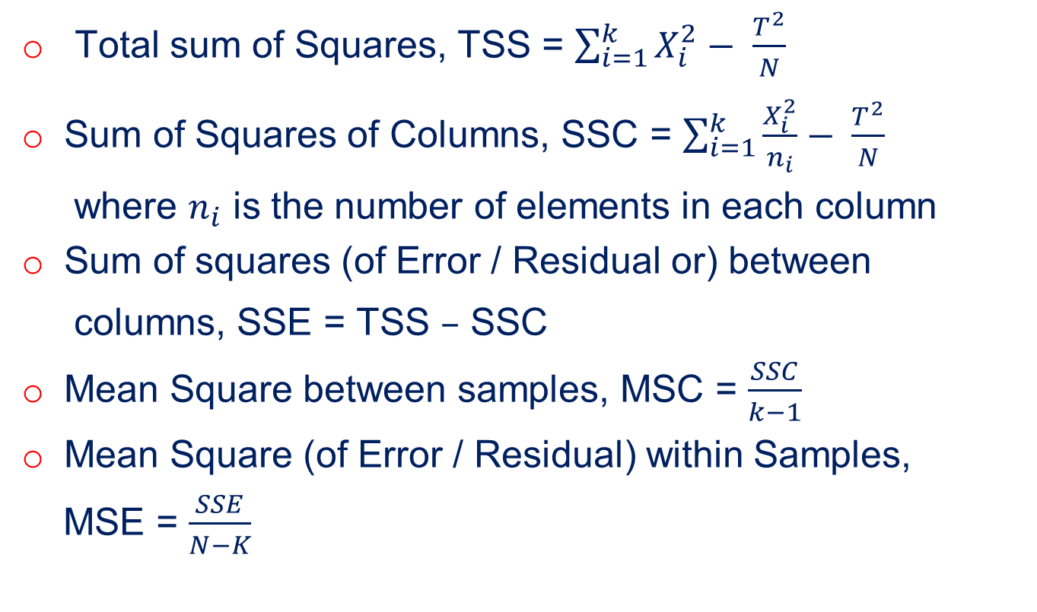
Calculate
Total sum of Squares, TSS = $\sum_{i=1}^{k}{X_{i}^{2}− \frac{T^{2}}{N}}$
Sum of Squares of Columns, SSC = $\sum_{i=1}^{k}{\frac{X_{i}^{2}}{n_{i}}− \frac{T^{2}}{N}}$
where $n_{i}$ is the number of elements in each column
Sum of squares (of Error / Residual or) between
columns, SSE = TSS $–$ SSC
Mean Square between samples, MSC = $\frac{SSC}{k−1}$
Mean Square (of Error / Residual) within Samples,
MSE = $\frac{SSE}{N−K}$

Slide 14
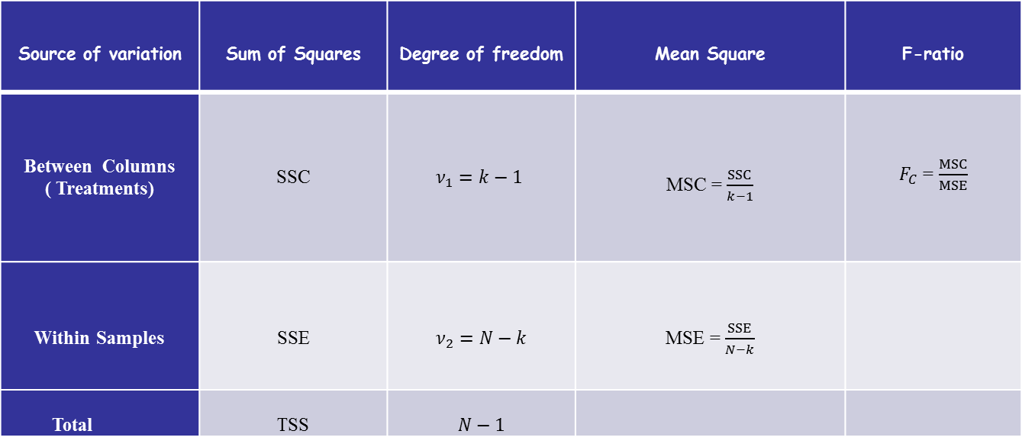
ANOVA TABLE FOR CRD
Source of variation | Sum of Squares | Degree of freedom | Mean Square | F-ratio
Between Columns ( Treatments) | SSC | $$ν_{1}=k−1$$ | MSC = $\frac{SSC}{k−1}$ | $F_{C}$ = $\frac{MSC}{MSE}$
Within Samples | SSE | $$ν_{2}=N−k$$ | MSE = $\frac{SSE}{N−k}$
Total | TSS | $$N−1$$

Slide 15
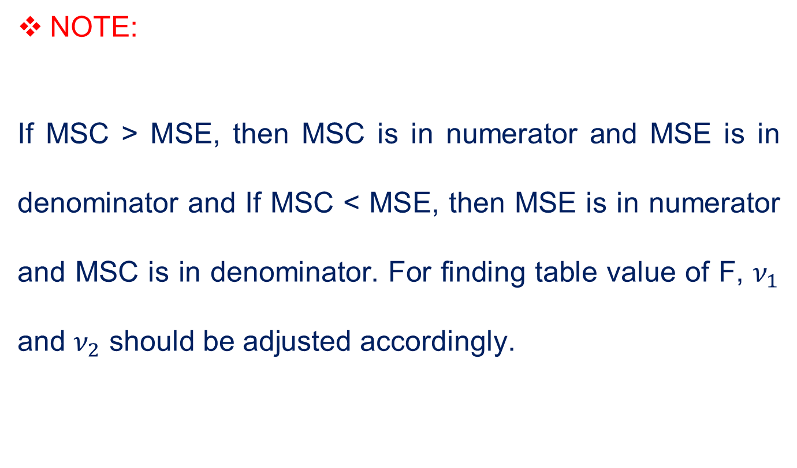
NOTE:
If MSC > MSE, then MSC is in numerator and MSE is in denominator and If MSC < MSE, then MSE is in numerator and MSC is in denominator. For finding table value of F, $ν_{1}$ and $ν_{2}$ should be adjusted accordingly.

Slide 16
Problem
The following table shows the lives in hours of four brands of electric lamps.
Perform an analysis of variance, test the homogeneity of the mean lives of the four brands of lamps.
Brand A | 1610 | 1610 | 1650 | 1680 | 1700 | 1720 | 1800
Brand B | 1580 | 1640 | 1640 | 1700 | 1750
Brand C | 1460 | 1550 | 1600 | 1620 | 1640 | 1660 | 1740 | 1820
Brand D | 1510 | 1520 | 1530 | 1570 | 1600 | 1680

Slide 17
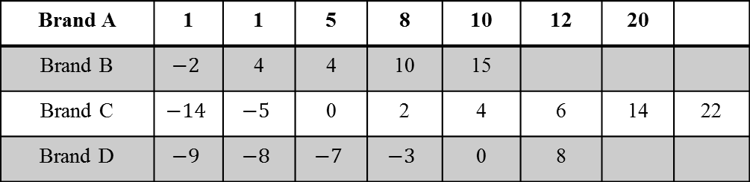
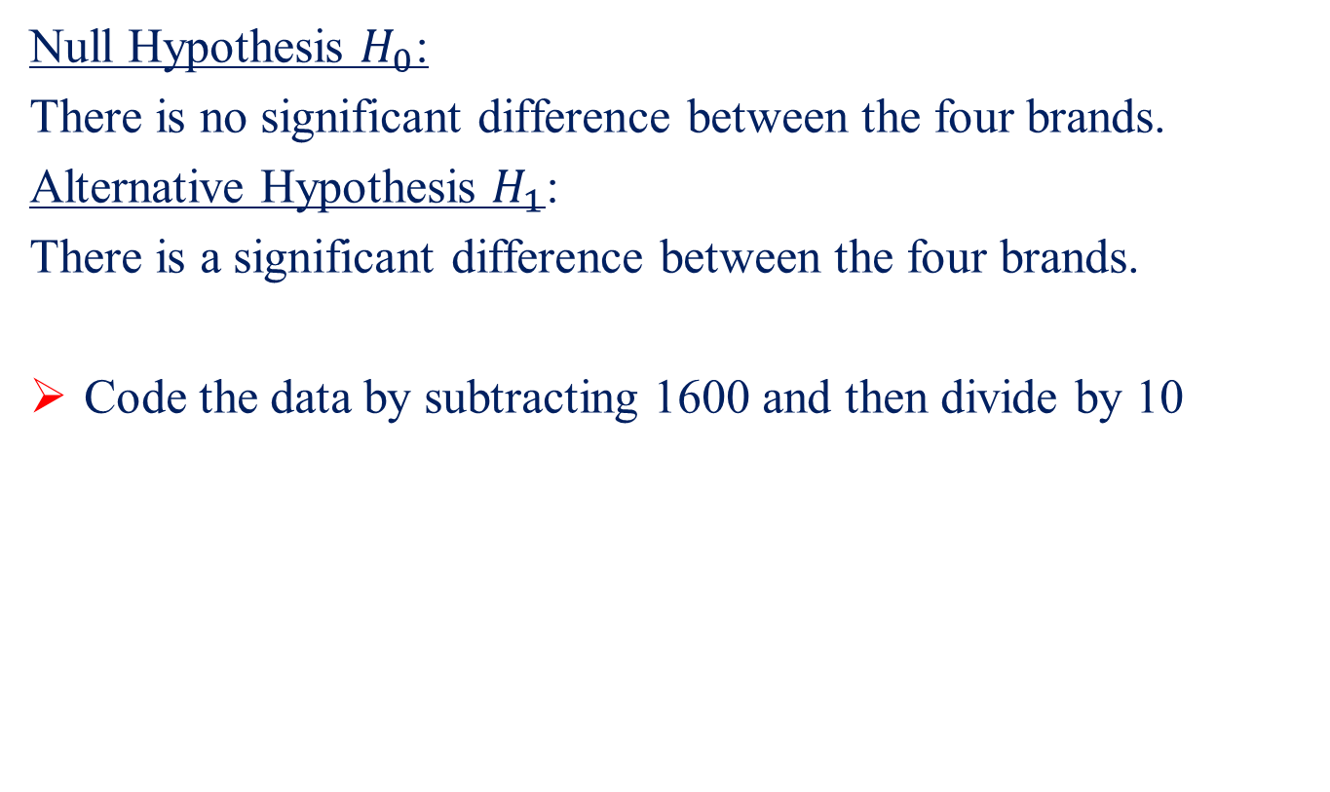
Solution
Null Hypothesis $H_{0}$:
There is no significant difference between the four brands.
Alternative Hypothesis $H_{1}$:
There is a significant difference between the four brands.
Code the data by subtracting 1600 and then divide by 10
Brand A | 1 | 1 | 5 | 8 | 10 | 12 | 20
Brand B | $$−2$$ | 4 | 4 | 10 | 15
Brand C | $$−14$$ | $$−5$$ | 0 | 2 | 4 | 6 | 14 | 22
Brand D | $$−9$$ | $$−8$$ | $$−7$$ | $$−3$$ | 0 | 8

Slide 18
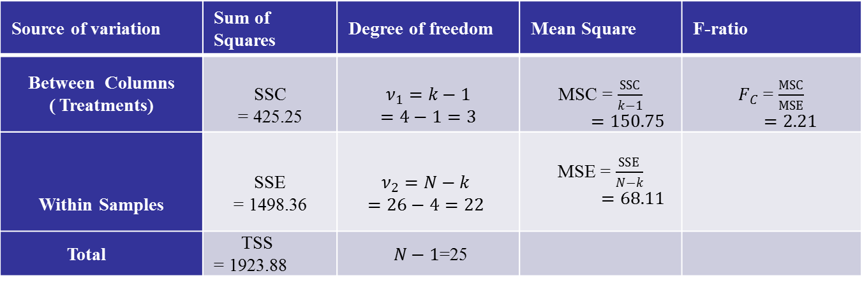
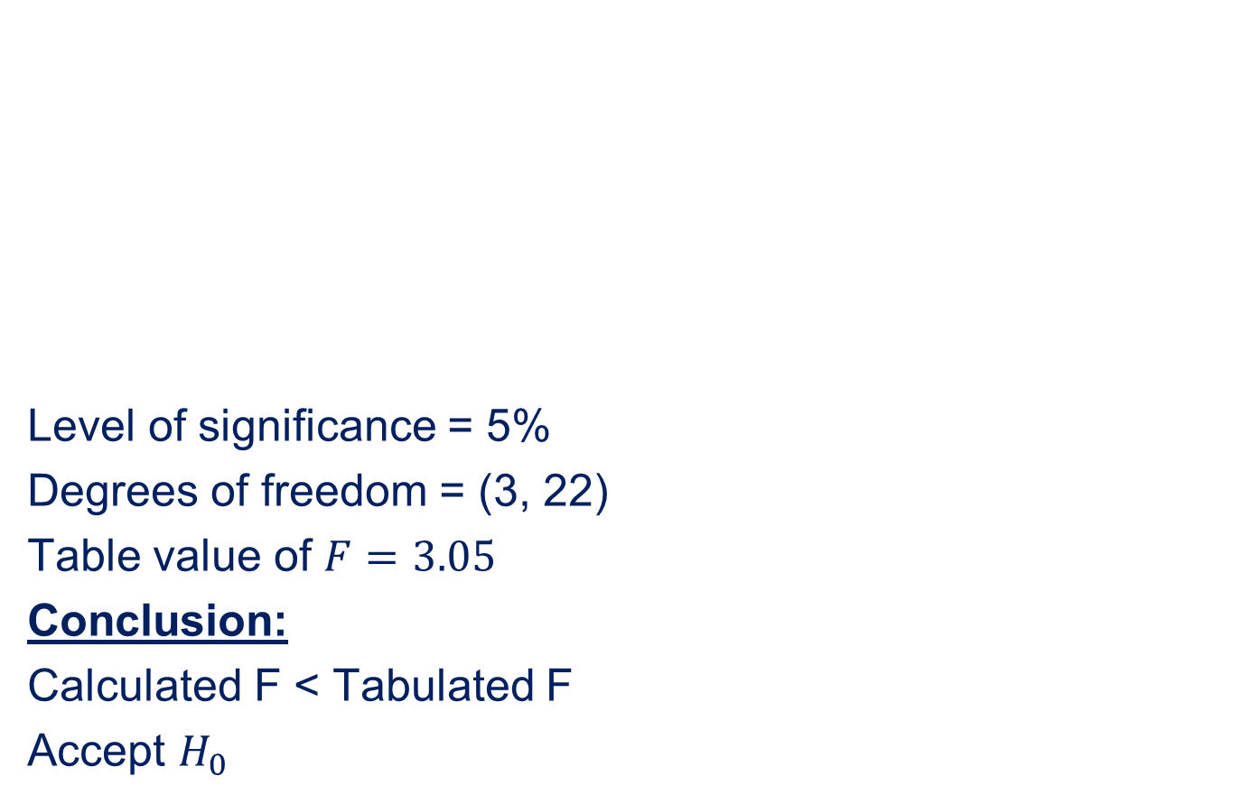
ANOVA TABLE
Level of significance = 5%
Degrees of freedom = (3, 22)
Table value of $F=3.05$
Conclusion:
Calculated F < Tabulated F
Accept $H_{0}$

Slide 19
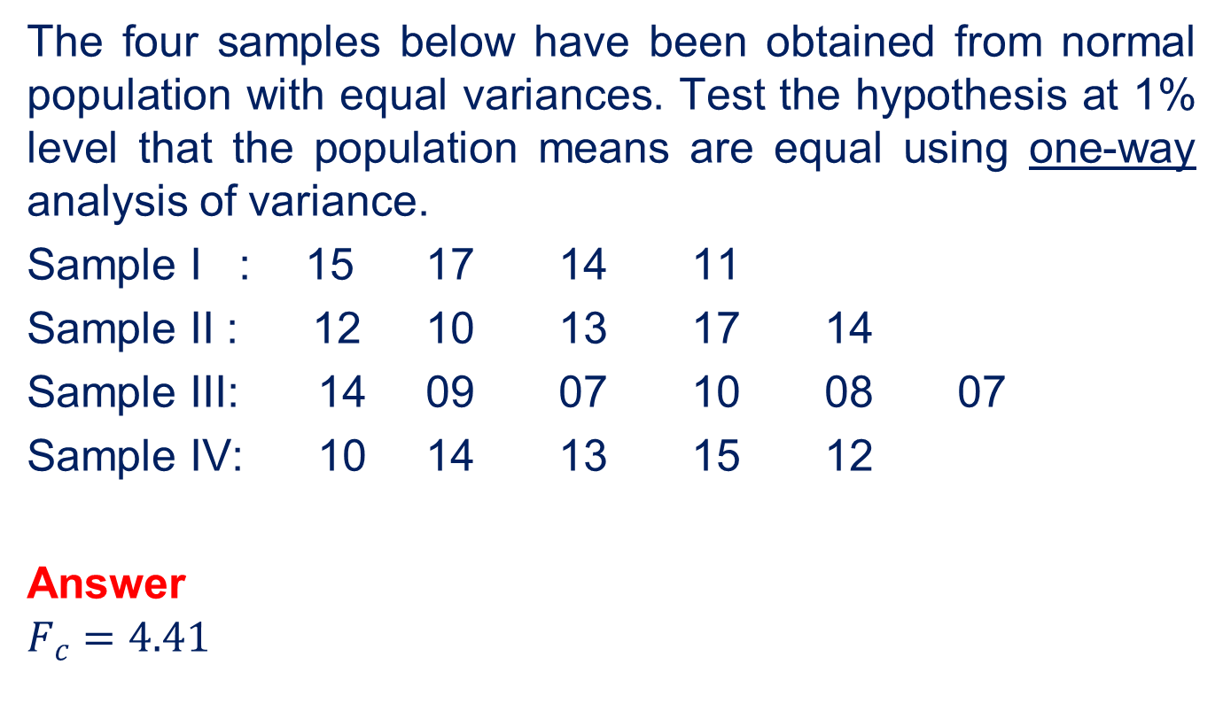
Problem
The four samples below have been obtained from normal population with equal variances. Test the hypothesis at 1% level that the population means are equal using one-way analysis of variance.
Sample I : 15 17 14 11
Sample II : 12 10 13 17 14
Sample III: 14 09 07 10 08 07
Sample IV: 10 14 13 15 12
Answer
$$F_{c}=4.41$$

Slide 20
Two-way classification Randomized Block Design (RBD)

Slide 21
In two-way classification, the data is classified according to two factor or criteria.
Randomized Block Design (RBD):
In RBD, entire experimental unit, which is heterogeneous is divided into homogeneous units known as blocks. In each block, treatments are distributed randomly and this is repeated for all blocks.

Slide 22
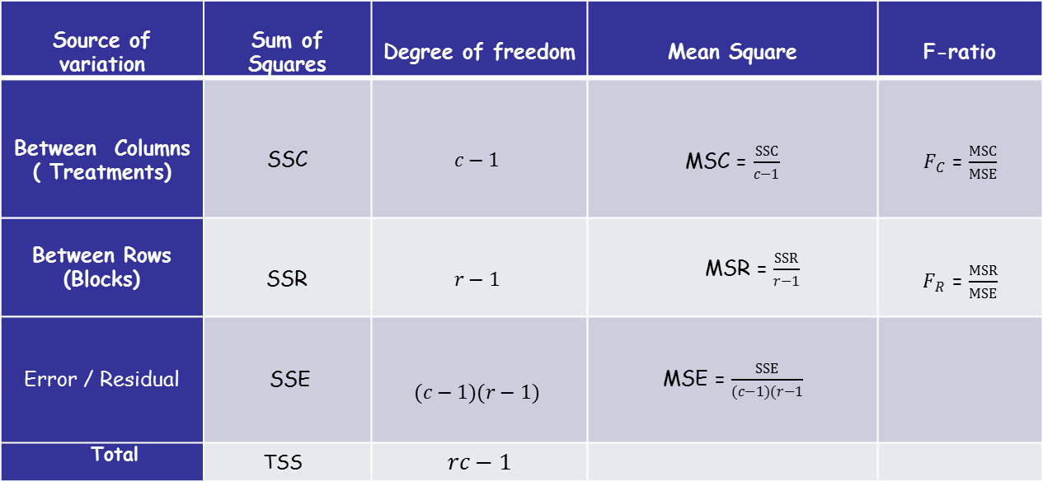
ANOVA TABLE FOR RBD
Source of variation | Sum of Squares | Degree of freedom | Mean Square | F-ratio
Between Columns ( Treatments) | SSC | $$c−1$$ | MSC = $\frac{SSC}{c−1}$ | $F_{C}$ = $\frac{MSC}{MSE}$
Between Rows (Blocks) | SSR | $$r−1$$ | MSR = $\frac{SSR}{r−1}$ | $F_{R}$ = $\frac{MSR}{MSE}$
Error / Residual | SSE | $$(c−1)(r−1)$$ | MSE = $\frac{SSE}{(c−1)(r−1}$
Total | TSS | $$rc−1$$

Slide 23
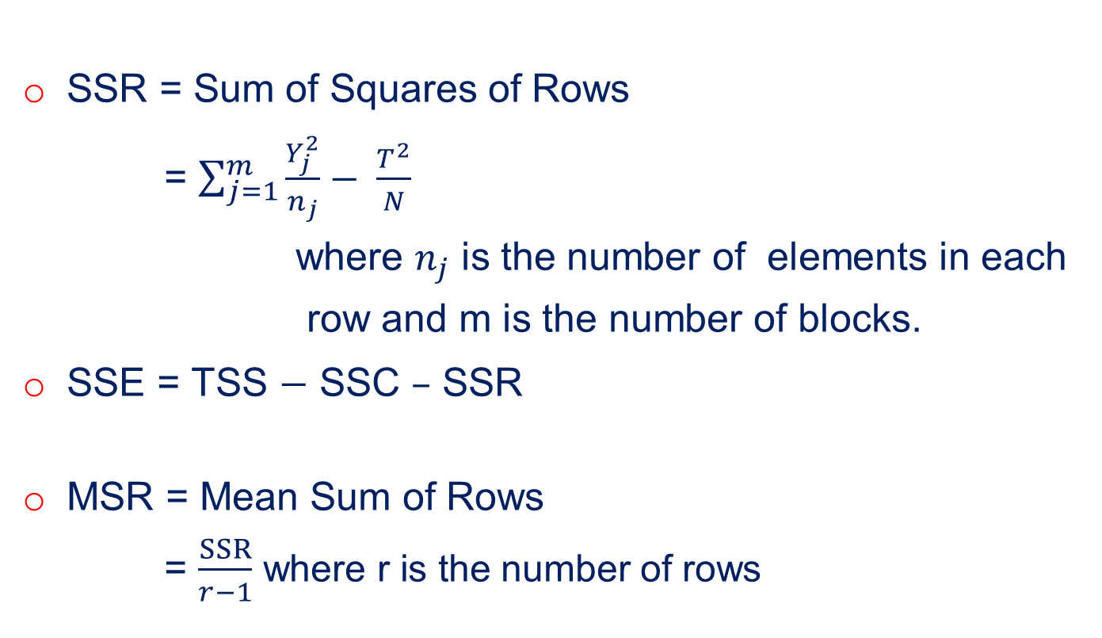
SSR = Sum of Squares of Rows
= $\sum_{j=1}^{m}{\frac{Y_{j}^{2}}{n_{j}}− \frac{T^{2}}{N}}$
where $n_{j}$ is the number of elements in each
row and m is the number of blocks.
SSE = TSS $−$ SSC $–$ SSR
MSR = Mean Sum of Rows
= $\frac{SSR}{r−1}$ where r is the number of rows

Slide 24
Comparison of One-way classification and Two-way classification:
 | One way classification | Two way classification
1 | One factor is involved | Two factors are involved
2 | Only one hypothesis is tested | Two hypothesis are tested
Comparison of CRD and RBD:
Both CRD and RBD are used to eliminate the influence of only one extraneous variable; however the ANOVA technique employed in CRD and RBD are one way classification and two way classification respectively.
In CRD, there are k independent groups of samples and in each group, there are m replications. In RBD, there are k treatments and m blocks, so that each treatment occurs only once in each block.

Slide 25
Problem
An experiment was designed to study the performance of 4 different detergents for cleaning fuel injectors. The following cleanliness readings were obtained with specifically designed equipment for 12 tanks of gas distributed over 3 different models of engines:
Perform the ANOVA and test at 0.01 level of significance, whether there are differences in the detergents or in the engines.
 | Engine 1 | Engine 2 | Engine 3
Detergent A | 45 | 43 | 51
Detergent B | 47 | 46 | 52
Detergent C | 48 | 50 | 55
Detergent D | 42 | 37 | 49

Slide 26
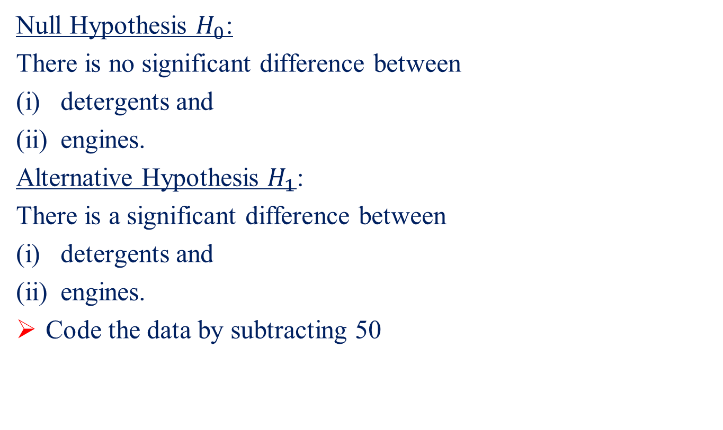
Solution
Null Hypothesis $H_{0}$:
There is no significant difference between
detergents and
engines.
Alternative Hypothesis $H_{1}$:
There is a significant difference between
detergents and
engines.
Code the data by subtracting 50

Slide 27
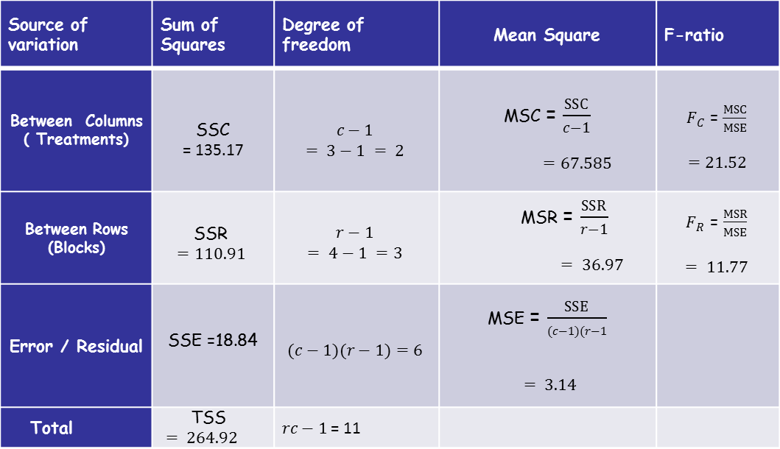
ANOVA TABLE
Source of variation | Sum of Squares | Degree of freedom | Mean Square | F-ratio
Between Columns ( Treatments) | SSC = 135.17 | $$c−1$$ $$= 3−1 = 2$$ | MSC = $\frac{SSC}{c−1}$ $=67.585$ | $F_{C}$ = $\frac{MSC}{MSE}$ $$=21.52$$
Between Rows (Blocks) | SSR $$=110.91$$ | $$r−1$$ $$= 4−1 =3$$ | MSR = $\frac{SSR}{r−1}$ $= 36.97$ | $F_{R}$ = $\frac{MSR}{MSE}$ $$= 11.77$$
Error / Residual | SSE =18.84 | $$(c−1)(r−1)=6$$ | MSE = $\frac{SSE}{(c−1)(r−1}$ $= 3.14$
Total | TSS $= 264.92$ | $rc−1$ = 11

Slide 28
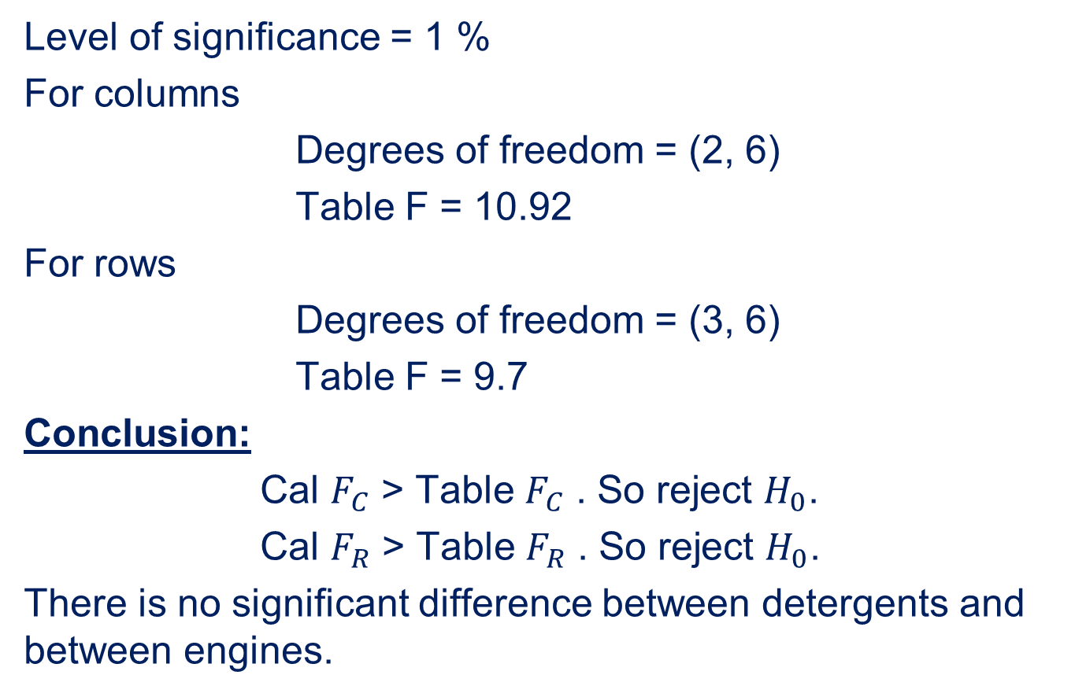
Level of significance = 1 %
For columns
Degrees of freedom = (2, 6)
Table F = 10.92
For rows
Degrees of freedom = (3, 6)
Table F = 9.7
Conclusion:
Cal $F_{C}$ > Table $F_{C}$ . So reject $H_{0}$.
Cal $F_{R}$ > Table $F_{R}$ . So reject $H_{0}$.
There is no significant difference between detergents and between engines.

Slide 29
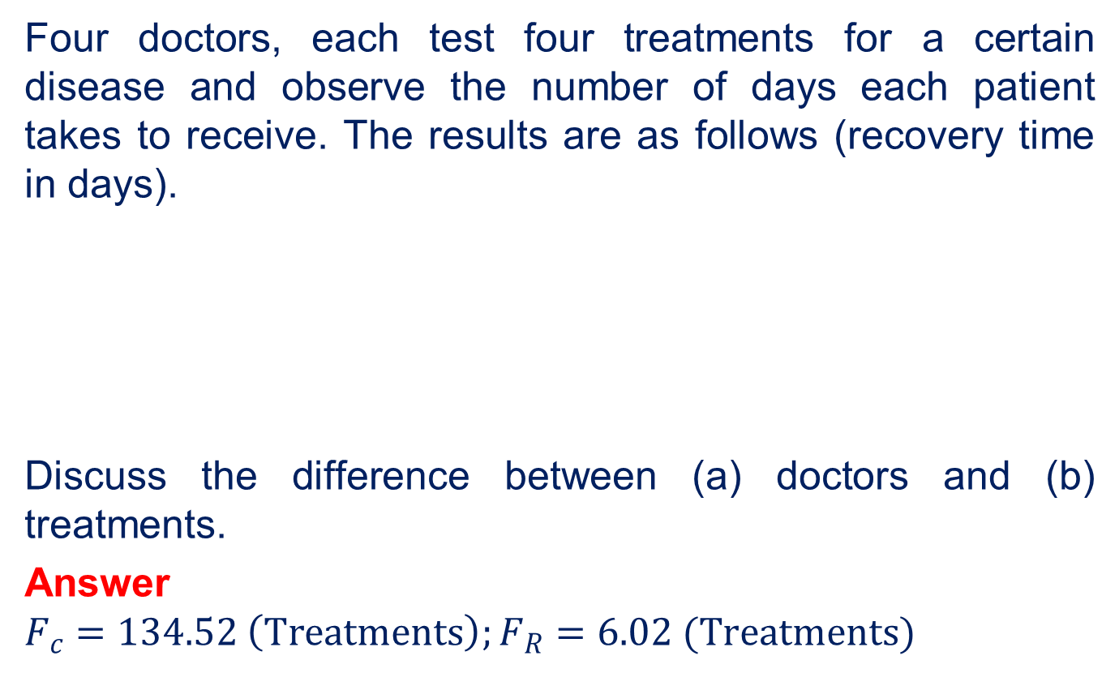
Problem
Four doctors, each test four treatments for a certain disease and observe the number of days each patient takes to receive. The results are as follows (recovery time in days).
Discuss the difference between (a) doctors and (b) treatments.
Answer
$$F_{c}=134.52 \left(Treatments\right);F_{R}=6.02 (Treatments)$$
Doctor | Treatment
 | 1 | 2 | 3 | 4
A | 10 | 14 | 19 | 20
B | 11 | 15 | 17 | 21
C | 9 | 12 | 16 | 19
D | 8 | 13 | 17 | 20

Slide 30
LATIN SQUARE DESIGN

Slide 31
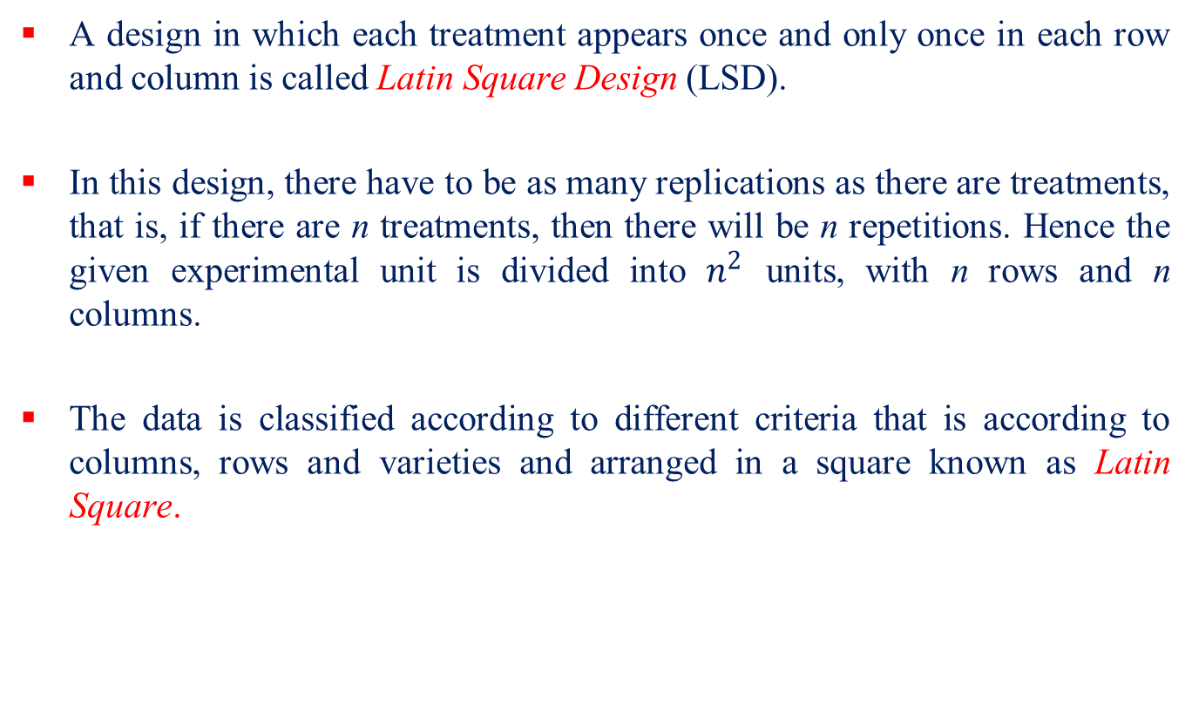
A design in which each treatment appears once and only once in each row and column is called Latin Square Design (LSD).
In this design, there have to be as many replications as there are treatments, that is, if there are n treatments, then there will be n repetitions. Hence the given experimental unit is divided into $n^{2}$ units, with n rows and n columns.
The data is classified according to different criteria that is according to columns, rows and varieties and arranged in a square known as Latin Square.
X | Y | Z | W
Y | Z | W | X
Z | W | X | Y
W | X | Y | Z

Slide 32
Assumption for LSD:
The factors are independent that is there is no interaction between different factors.
Advantages of Latin Square Design:
The fundamental assumption that the factors are independent that is there is no interaction between different factors may not be true in general.
Unlike RBD, the number of treatments is restricted to the number of repetitions. So LSD is suitable for the number of treatments between 5 and 10.
The process of randomization is not as simple as in RBD.
The experimental area should be in the form of a square.

Slide 33
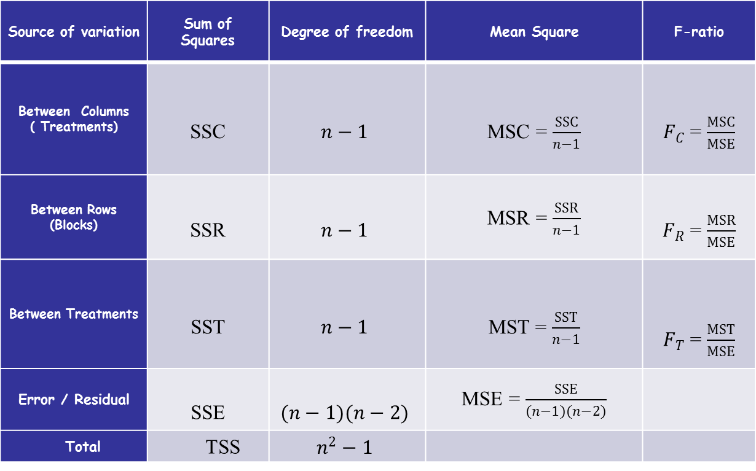
ANOVA TABLE FOR LSD
Source of variation | Sum of Squares | Degree of freedom | Mean Square | F-ratio
Between Columns ( Treatments) | SSC | $$n−1$$ | MSC = $\frac{SSC}{n−1}$ | $F_{C}$ = $\frac{MSC}{MSE}$
Between Rows (Blocks) | SSR | $$n−1$$ | MSR = $\frac{SSR}{n−1}$ | $F_{R}$ = $\frac{MSR}{MSE}$
Between Treatments | SST | $$n−1$$ | MST = $\frac{SST}{n−1}$ | $F_{T}$ = $\frac{MST}{MSE}$
Error / Residual | SSE | $$(n−1)(n−2)$$ | MSE = $\frac{SSE}{(n−1)(n−2)}$
Total | TSS | $$n^{2}−1$$

Slide 34
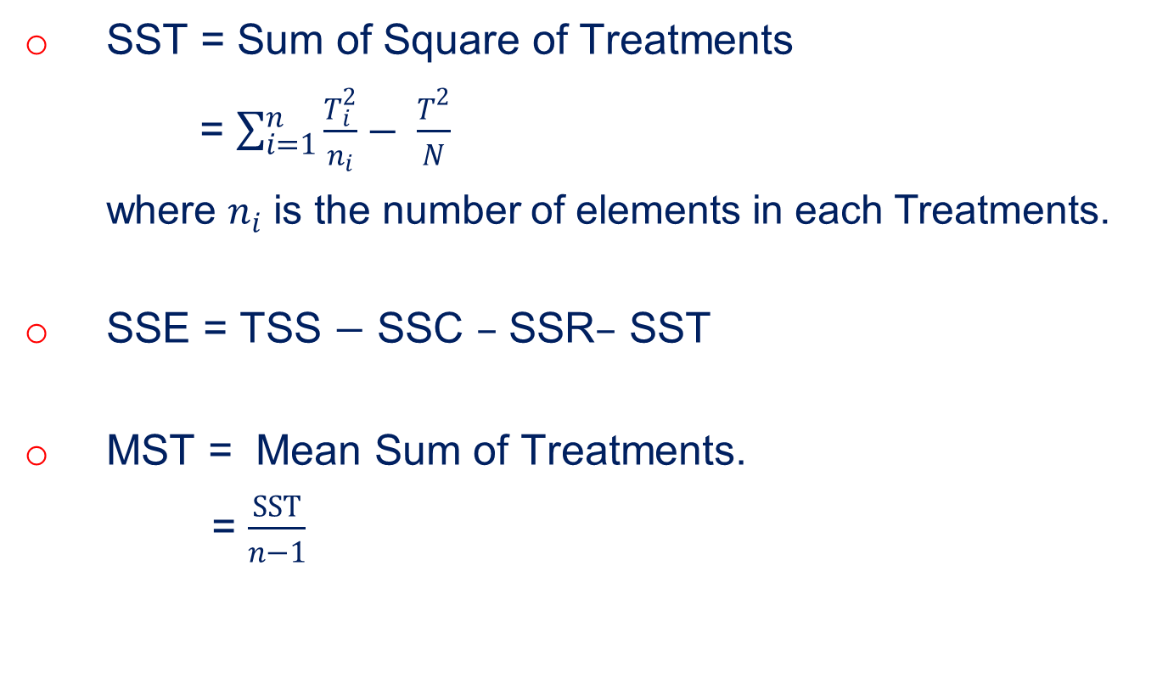
SST = Sum of Square of Treatments
= $\sum_{i=1}^{n}{\frac{T_{i}^{2}}{n_{i}}− \frac{T^{2}}{N}}$
where $n_{i}$ is the number of elements in each Treatments.
SSE = TSS $−$ SSC $–$ SSR$–$ SST
MST = Mean Sum of Treatments.
= $\frac{SST}{n−1}$

Slide 35
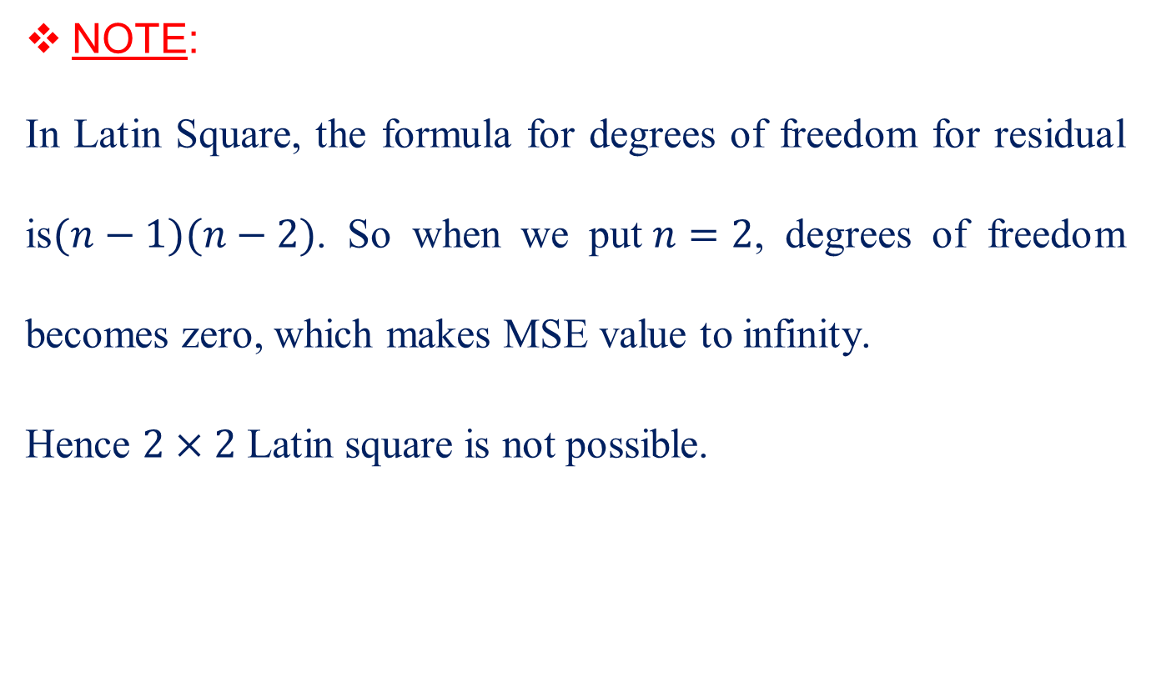
NOTE:
In Latin Square, the formula for degrees of freedom for residual is$(n−1)(n−2)$. So when we put$n=2$, degrees of freedom becomes zero, which makes MSE value to infinity.
Hence $2×2$ Latin square is not possible.

Slide 36
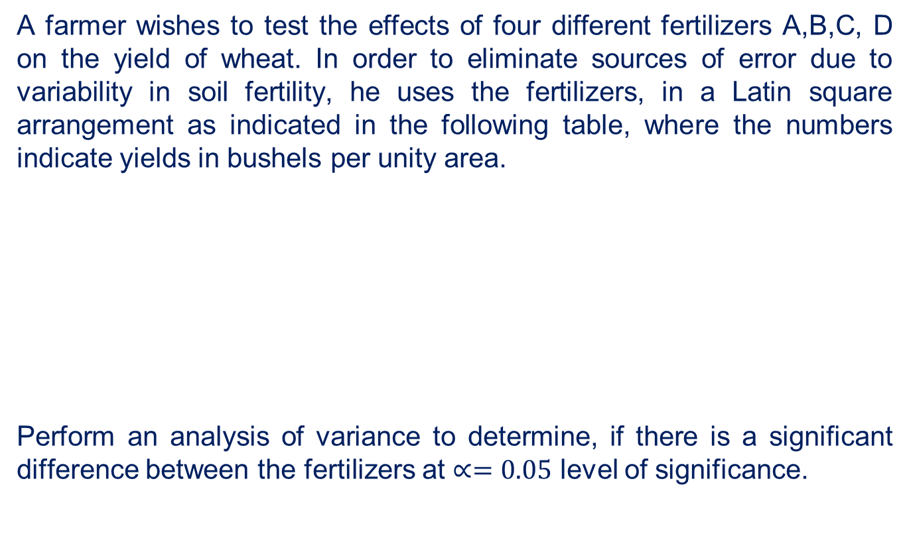
Problem
A farmer wishes to test the effects of four different fertilizers A,B,C, D on the yield of wheat. In order to eliminate sources of error due to variability in soil fertility, he uses the fertilizers, in a Latin square arrangement as indicated in the following table, where the numbers indicate yields in bushels per unity area.
Perform an analysis of variance to determine, if there is a significant difference between the fertilizers at $∝=0.05$ level of significance.
A 18 | C 21 | D 25 | B 11
D 22 | B 12 | A 15 | C 19
B 15 | A 20 | C 23 | D 24
C 22 | D 21 | B 10 | A 17

Slide 37

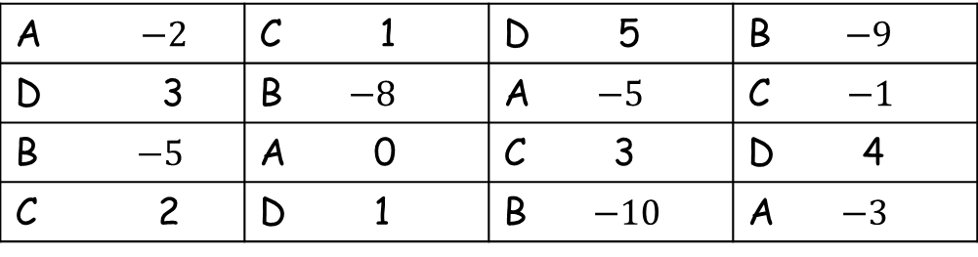
Solution
Null hypothesis $H_{0}:$ There is no significant difference between rows, columns and treatments.
Alternative hypothesis $H_{1}:$ There is a significant difference between rows, columns and treatments.
Code the data by subtracting 20 from all the values
A $−2$ | C 1 | D 5 | B$−9$
D 3 | B $−8$ | A$−5$ | C $−1$
B$−5$ | A 0 | C 3 | D 4
C 2 | D 1 | B $−10$ | A $−3$

Slide 38
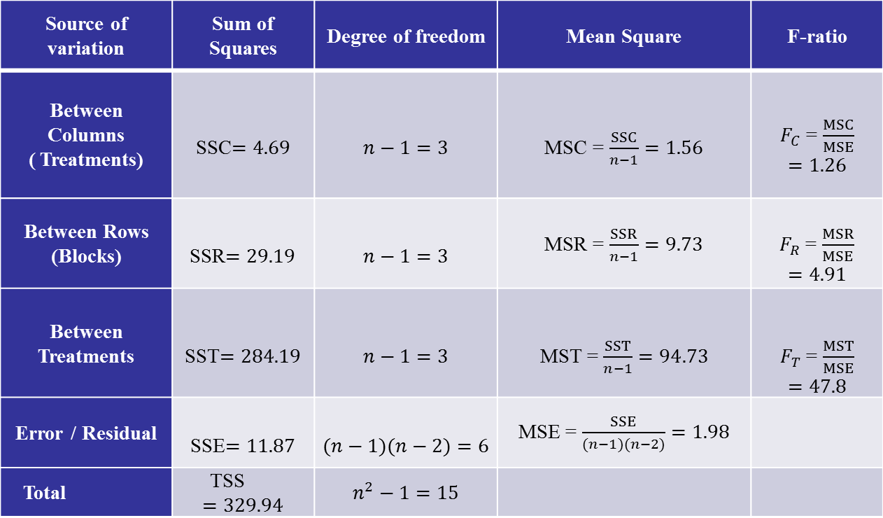
ANOVA TABLE
Source of variation | Sum of Squares | Degree of freedom | Mean Square | F-ratio
Between Columns ( Treatments) | SSC$=4.69$ | $$n−1=3$$ | MSC = $\frac{SSC}{n−1}=1.56$ | $F_{C}$ = $\frac{MSC}{MSE}$ $$=1.26$$
Between Rows (Blocks) | SSR$=29.19$ | $$n−1=3$$ | MSR = $\frac{SSR}{n−1}=9.73$ | $F_{R}$ = $\frac{MSR}{MSE}$ $$=4.91$$
Between Treatments | SST$=284.19$ | $$n−1=3$$ | MST = $\frac{SST}{n−1}=94.73$ | $F_{T}$ = $\frac{MST}{MSE}$ $$=47.8$$
Error / Residual | SSE$=11.87$ | $$(n−1)(n−2)=6$$ | MSE = $\frac{SSE}{(n−1)(n−2)}=1.98$
Total | TSS $$=329.94$$ | $$n^{2}−1=15$$

Slide 39
Level of significance = 5%
For Columns
Degrees of freedom = (6, 3)
Table F = 8.94
For Rows
Degrees of freedom = (3, 6)
Table F = 4.76
For Treatments
Degrees of freedom = (3, 6)
Table F = 4.76

Slide 40
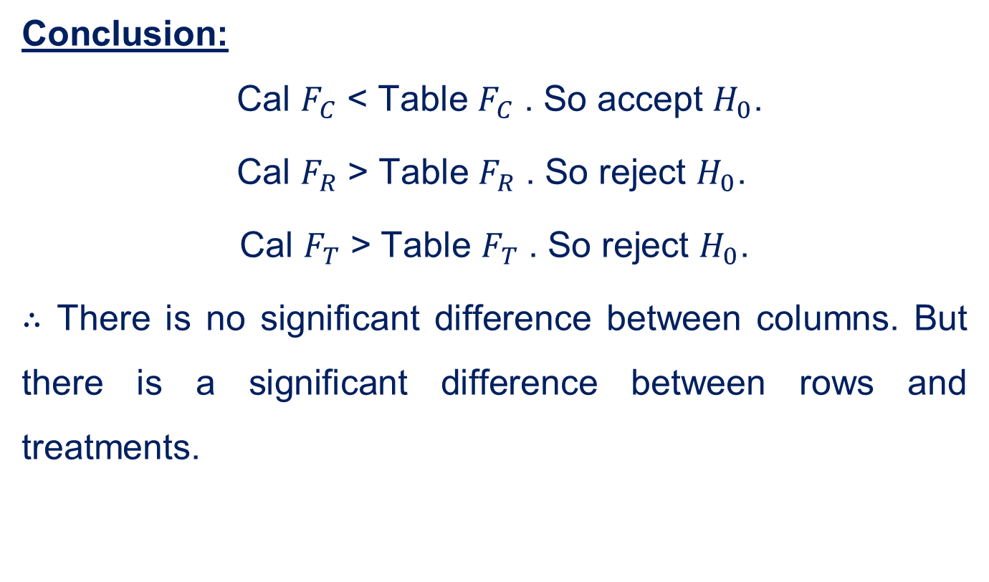
Conclusion:
Cal $F_{C}$ < Table $F_{C}$ . So accept $H_{0}$.
Cal $F_{R}$ > Table $F_{R}$ . So reject $H_{0}$.
Cal $F_{T}$ > Table $F_{T}$ . So reject $H_{0}$.
$∴$ There is no significant difference between columns. But there is a significant difference between rows and treatments.

Slide 41
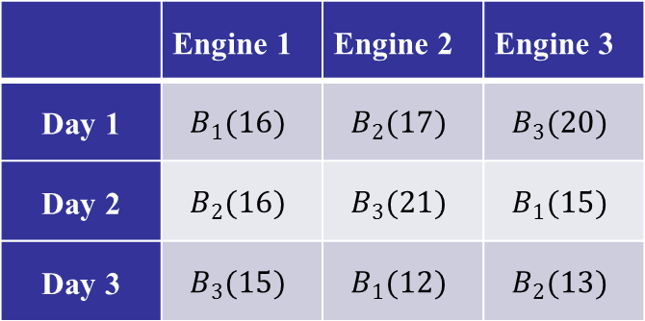
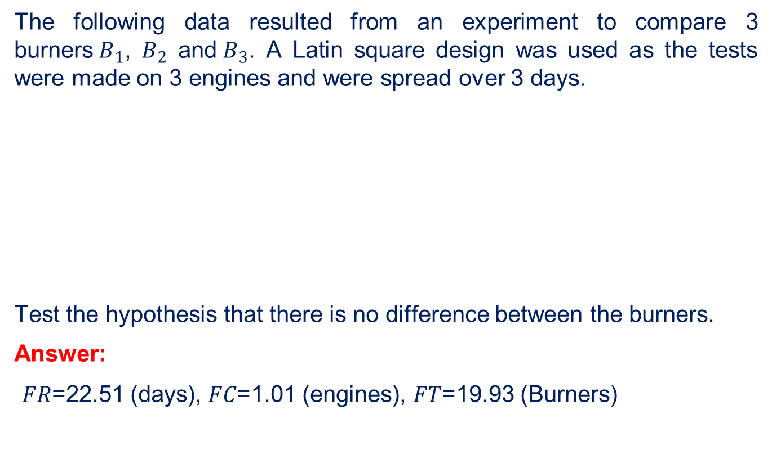
Problem
The following data resulted from an experiment to compare 3 burners${ B}_{1}$, $B_{2}$ and$B_{3}$. A Latin square design was used as the tests were made on 3 engines and were spread over 3 days.
Test the hypothesis that there is no difference between the burners.
Answer:
𝐹𝑅=22.51 (days), 𝐹𝐶=1.01 (engines), 𝐹𝑇=19.93 (Burners)
 | Engine 1 | Engine 2 | Engine 3
Day 1 | $$B_{1}(16)$$ | $$B_{2}(17)$$ | $$B_{3}(20)$$
Day 2 | $$B_{2}(16)$$ | $$B_{3}(21)$$ | $$B_{1}(15)$$
Day 3 | $$B_{3}(15)$$ | $$B_{1}(12)$$ | $$B_{2}(13)$$

Slide 42
2 ² Factorial Design

Slide 43
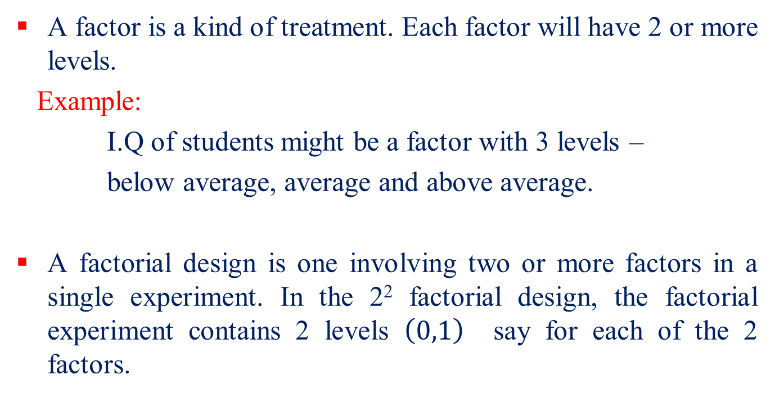
The aim in the factorial experiment is to carry out separate tests for the main effects K, P and its combination KP, splitting the sum of squares with 3 degrees of freedom.
A factor is a kind of treatment. Each factor will have 2 or more levels.
Example:
I.Q of students might be a factor with 3 levels –
below average, average and above average.
A factorial design is one involving two or more factors in a single experiment. In the 2² factorial design, the factorial experiment contains 2 levels $\left(0,1\right)$ say for each of the 2 factors.

Slide 44
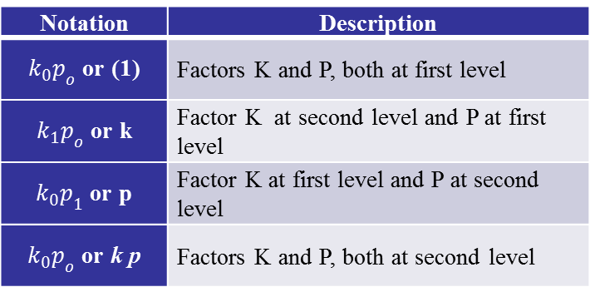
In the 2² factorial design, we consider two factors K and P. Let k and p denote one of the 2 levels of each of the corresponding factor and this will be called second level. If both factors are absent, then we consider it as level one.
The 4 treatment combinations can be enumerated in the following table:
Notation | Description
$k_{0}p_{o}$ or (1) | Factors K and P, both at first level
$k_{1}p_{o}$ or k | Factor K at second level and P at first level
$k_{0}p_{1}$ or p | Factor K at first level and P at second level
$k_{0}p_{o}$ or k p | Factors K and P, both at second level

Slide 45
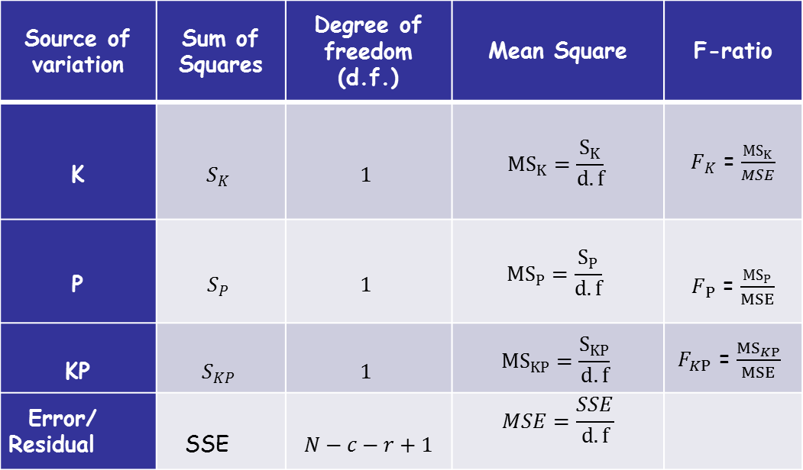
ANOVA TABLE FOR 2 ² FACTORIAL DESIGN
Source of variation | Sum of Squares | Degree of freedom (d.f.) | Mean Square | F-ratio
K | $$S_{K}$$ | $$1$$ | $${MS}_{K}=\frac{S_{K}}{d.f}$$ | $F_{K}$ = $\frac{{MS}_{K}}{MSE}$
P | $$S_{P}$$ | $$1$$ | $${MS}_{P}=\frac{S_{P}}{d.f}$$ | $F_{P}$ = $\frac{{MS}_{P}}{MSE}$
KP | $$S_{KP}$$ | $$1$$ | $${MS}_{KP}=\frac{S_{KP}}{d.f}$$ | $F_{KP}$ = $\frac{{MS}_{KP}}{MSE}$
Error/ Residual | SSE | $$N−c−r+1$$ | $$MSE=\frac{SSE}{d.f}$$

Slide 46
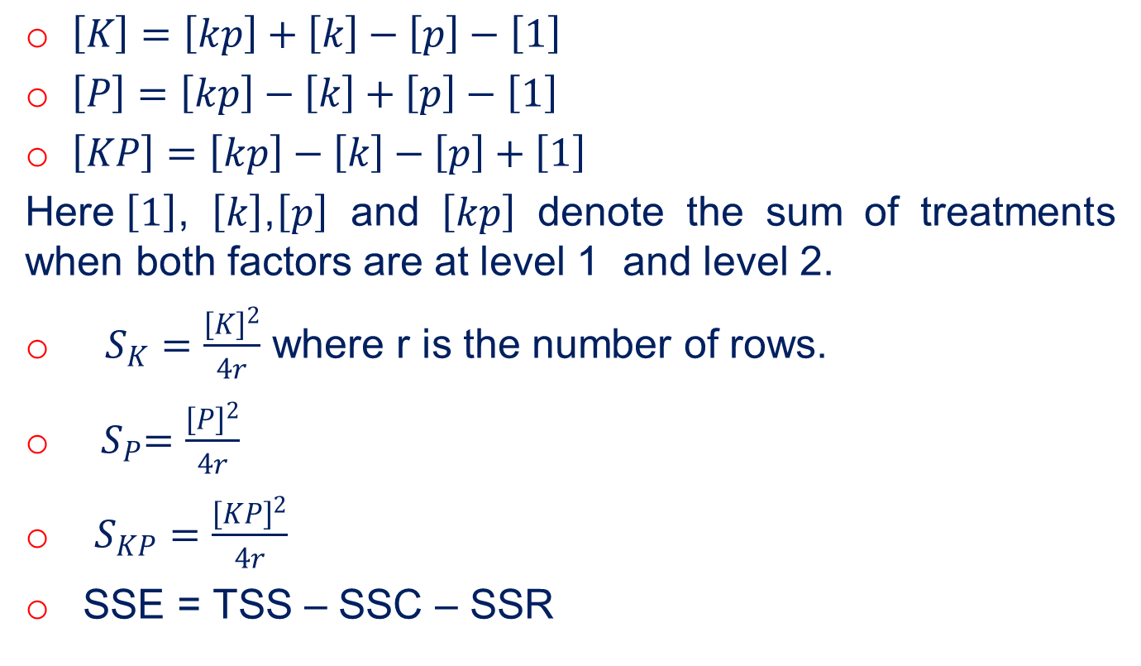
$\left[K\right]=\left[kp\right]+\left[k\right]−\left[p\right]−\left[1\right]$
$\left[P\right]=\left[kp\right]−\left[k\right]+\left[p\right]−\left[1\right]$
$\left[KP\right]=\left[kp\right]−\left[k\right]−\left[p\right]+\left[1\right]$
Here$\left[1\right]$, $\left[k\right]$,$\left[p\right]$ and $\left[kp\right]$ denote the sum of treatments when both factors are at level 1 and level 2.
$S_{K}=\frac{{\left[K\right]}^{2}}{4r}$ where r is the number of rows.
${ S}_{P}=\frac{{\left[P\right]}^{2}}{4r}$
$S_{KP}=\frac{{\left[KP\right]}^{2}}{4r}$
SSE = TSS – SSC – SSR

Slide 47
Problem
An experiment was planned to study the effect of potash and super phosphate on the yield of potatoes. All the combinations of 2 levels of super phosphate and two levels of potash were studied in a randomized block design with 4 replications for each. The yields (per plot) obtained are given in the following table.
.
Analyze the data and comment on your finds.
Block | Yields (lb. per plot)
I | (1) 23 | k 25 | p 22 | kp 38
II | p 40 | (1) 26 | k 36 | Kp 38
III | (1) 29 | k 20 | kp 30 | P 20
IV | kp 34 | k 31 | P 24 | (1) 28

Slide 48
Solution
Rearranging the data based on treatments, we get
Treatment Combination | Blocks
 | I | II | III | IV
(1) | 23 | 26 | 29 | 28
k | 25 | 36 | 20 | 31
p | 22 | 40 | 20 | 24
kp | 38 | 38 | 30 | 34

Slide 49
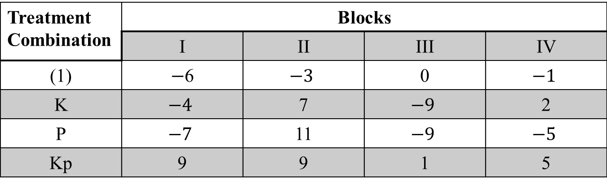
Code the data by subtracting 29, we get
Treatment Combination | Blocks
 | I | II | III | IV
(1) | $−$6 | $$−3$$ | 0 | $$−1$$
K | $$−4$$ | 7 | $$−9$$ | 2
P | $$−7$$ | 11 | $$−9$$ | $$−5$$
Kp | 9 | 9 | 1 | 5

Slide 50
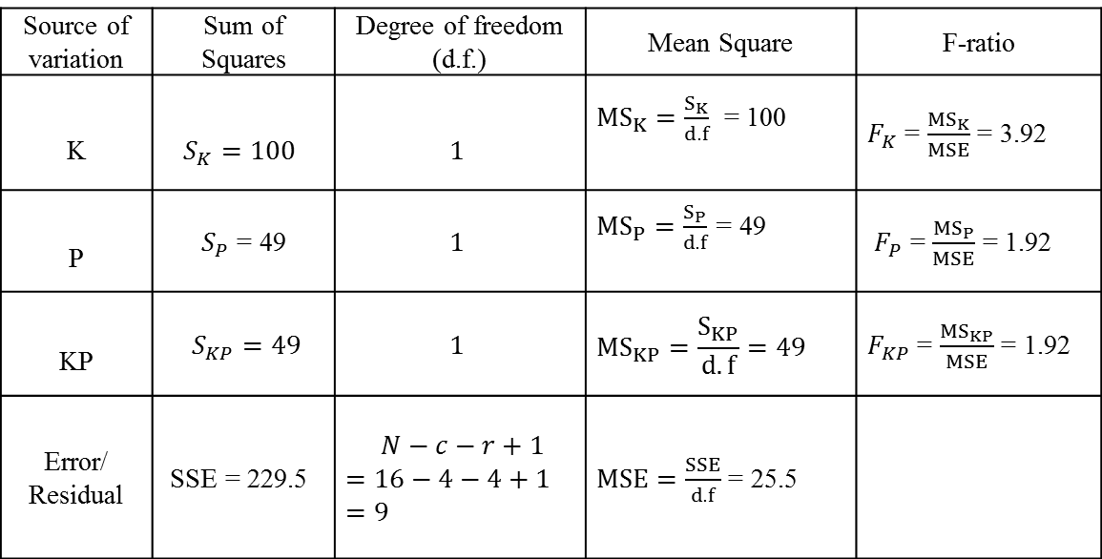

Null hypothesis $H_{0}$:
The data is homogeneous with respect to the blocks and treatments.
Source of variation | Sum of Squares | Degree of freedom (d.f.) | Mean Square | F-ratio
K | $$S_{K}=100$$ | $$1$$ | ${MS}_{K}=\frac{S_{K}}{d.f}$ = 100 | $F_{K}$ = $\frac{{MS}_{K}}{MSE}$ = 3.92
P | $S_{P}$ = 49 | $$1$$ | ${MS}_{P}=\frac{S_{P}}{d.f}$ = 49 | $F_{P}$ = $\frac{{MS}_{P}}{MSE}$ = 1.92
KP | $S_{KP}=49$ | $$1$$ | $${MS}_{KP}=\frac{S_{KP}}{d.f}=49$$ | $F_{KP}$ = $\frac{{MS}_{KP}}{MSE}$ = 1.92
Error/ Residual | SSE = 229.5 | $N−c−r+1$ $$=16−4−4+1$$ $$=9$$ | $MSE=\frac{SSE}{d.f}$ = 25.5

Slide 51
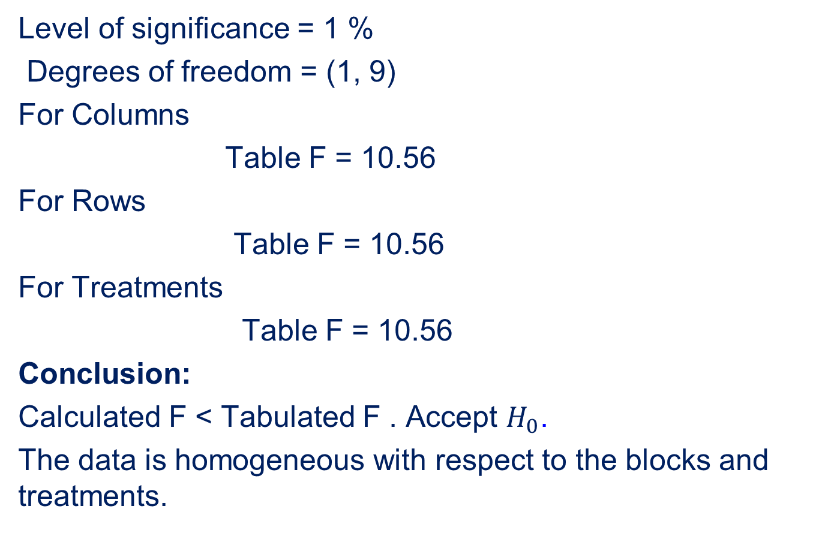
Level of significance = 1 %
Degrees of freedom = (1, 9)
For Columns
Table F = 10.56
For Rows
Table F = 10.56
For Treatments
Table F = 10.56
Conclusion:
Calculated F < Tabulated F . Accept $H_{0}$.
The data is homogeneous with respect to the blocks and treatments.

Slide 52
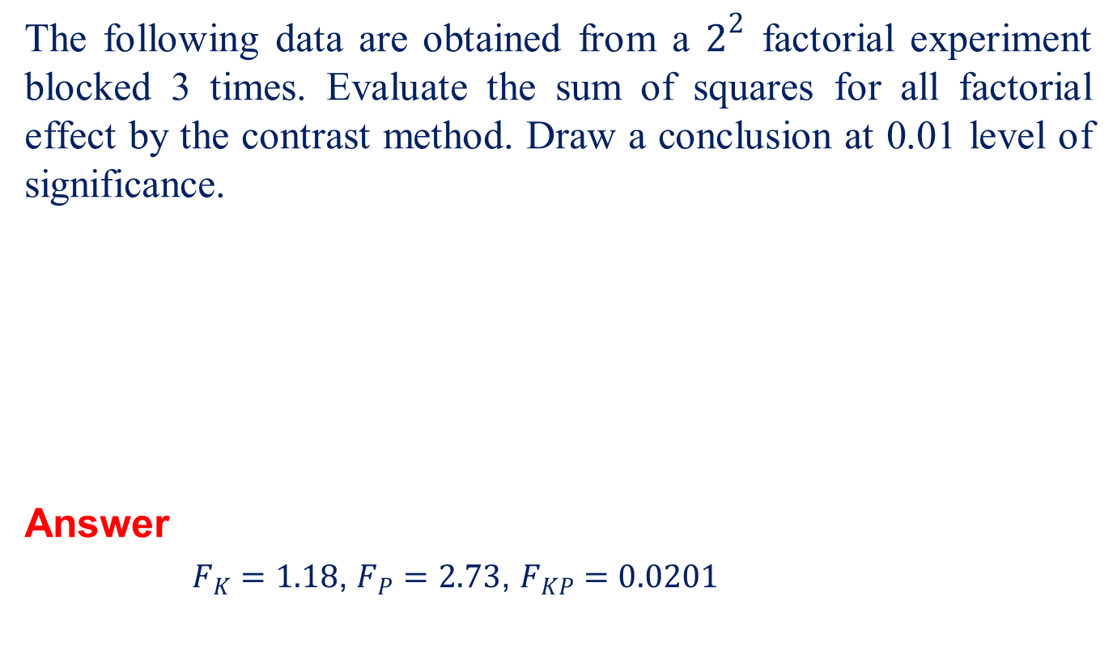
Problem
The following data are obtained from a $2^{2}$ factorial experiment blocked 3 times. Evaluate the sum of squares for all factorial effect by the contrast method. Draw a conclusion at 0.01 level of significance.
Answer
$F_{K}=1.18$, $F_{P}=2.73$, $F_{KP}=0.0201$
Treatment Combination | BLOCKS
 | I | II | III
(1) | 12 | 19 | 10
K | 15 | 20 | 16
P | 24 | 16 | 17
KP | 24 | 17 | 29

Slide 53
REFERENCES
Walpole. R.E., Myers. R.H., Myers. S.L., and Ye. K., “ Probability and Statistics for Engineers and Scientists”, 8th Edition, Pearson Education, Asia, 2007.
Spiegel. M.R., Schiller.J., and Srinivasan. R.A., “ Schaum’s Outlines on Probabilty and Statistics”, Tata McGraw Hill, Edition 2004

